Slide 1
Design Patterns
The Strategy Pattern
IT 426

Slide 2

Definition
Gang of four:
“Define a family of algorithms, encapsulate each one, and make them interchangeable. Strategy lets the algorithm vary independently from clients that use it.”

Slide 3
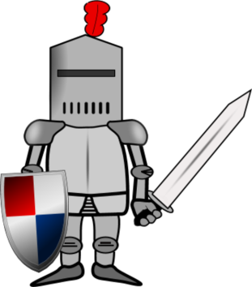
Let’s build an adventure game!
Our game will include:
Adventurers:
Knights
Squires
Adventurers can have names and will have to brave adventures
Adventurers can equip themselves with weapons to defend themselves

Slide 4
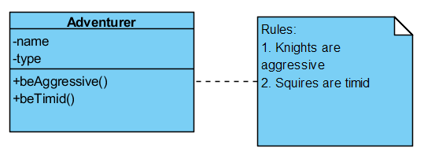
Building the adventure class
This works fine for the two objects we have in mind
What if we add a third adventurer?

Slide 5

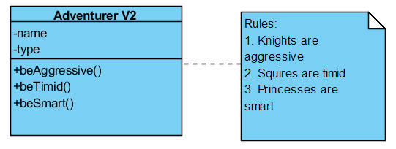
Adding a new object to our design
Let’s add a princess adventurer

Slide 6
Open-closed principle
We have broken a well known design rule called the “open-closed principle”
When adding features to a class, a class should be:
Open for extension (inheritance)
Closed for modification
Modification is allowed only to fix bugs
Updates or new features should be placed in a new class

Slide 7
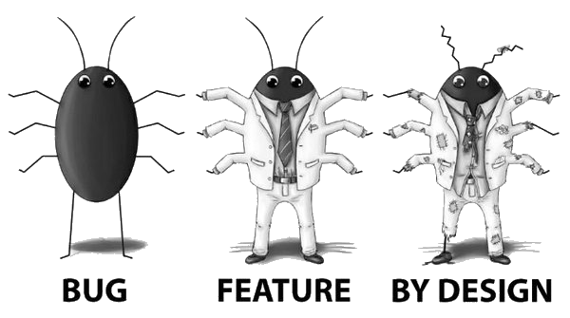
Why is this important?
Dependent classes can become broken through your changes
Leading to
Code reviews - reviewing your peer’s code for mistakes, errors or design flaws
Unit tests - testing small code segments (units), typically methods
Software regression - a software bug that, when introduced, breaks an existing feature

Slide 8
Open-closed principle
“When a single change to a program results in a cascade of changes to dependent modules, that program exhibits the undesirable attributes that we have come to associate with “bad” design. The program becomes fragile, rigid, unpredictable and unreusable. The open-closed principle attacks this in a very straightforward way. It says that you should design modules that never change.”
- Bertrand Meyer

Slide 9
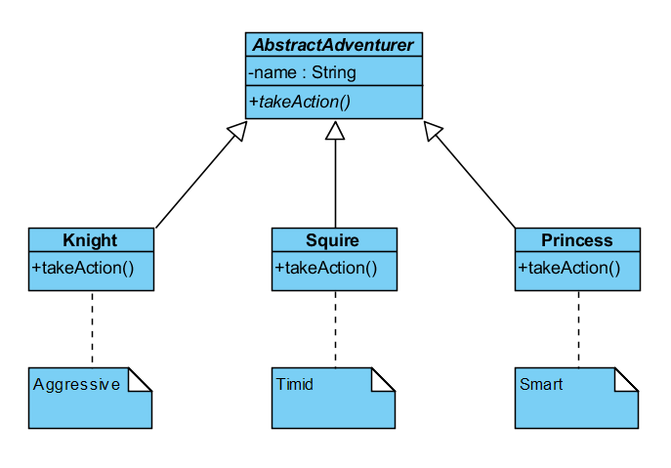
Inheritance
What if we instead tried to implement each adventurer in their own class using inheritance?

Slide 10
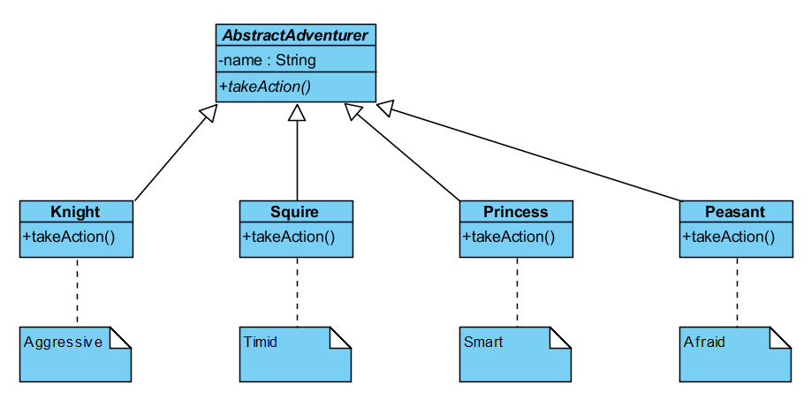
Add a new adventurer
Adding a new adventurer, let’s say a “peasant”, would not require changing any existing classes

Slide 11
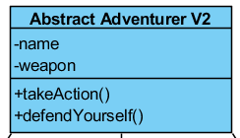
Does our design work well?
If we keep adding new adventurers?
If we keep adding features to an adventurer?
How would we add a “weapon” feature to our game?

Slide 12
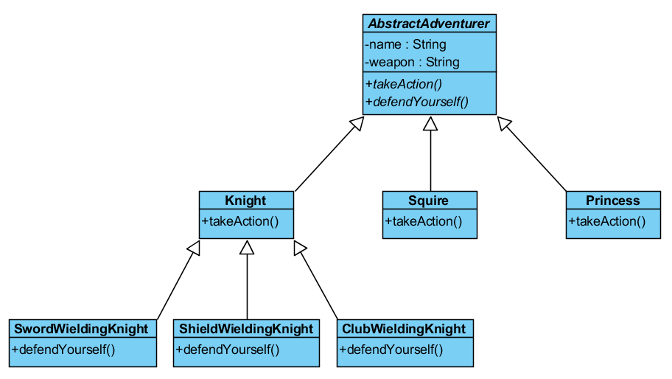
Inheritance

Slide 13

Key observations
Inheritance does not serve us well here
This design will result in an exponential number of classes (each new feature makes this worse)
We cannot create a new Weapon class without creating a new class for each Adventurer

Slide 14
Primary design pattern principles
Favor composition over inheritance
Program against interfaces
Find what varies and encapsulate it
1
2
3

Slide 15
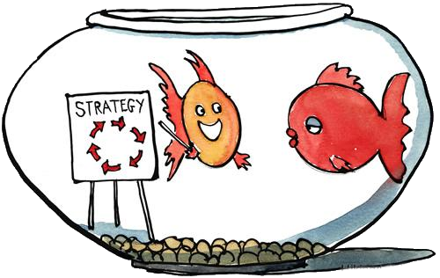
The Strategy pattern
Behavioral pattern
Participants
Context: ”A class with a configurable algorithm or behavior”
Strategy: ”Defines an interface common to all […] strategy classes”
Concrete Strategy: A class which uses the strategy interface and provides an implementation of the algorithm required by the context.

Slide 16
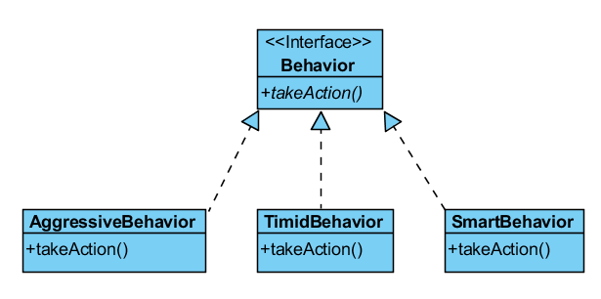
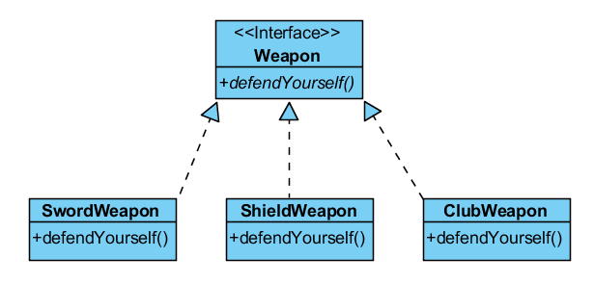
Step 1: encapsulate what varies
Create an interface for each family of algorithms
Create a concrete class for each implementation of the algorithm

Slide 17
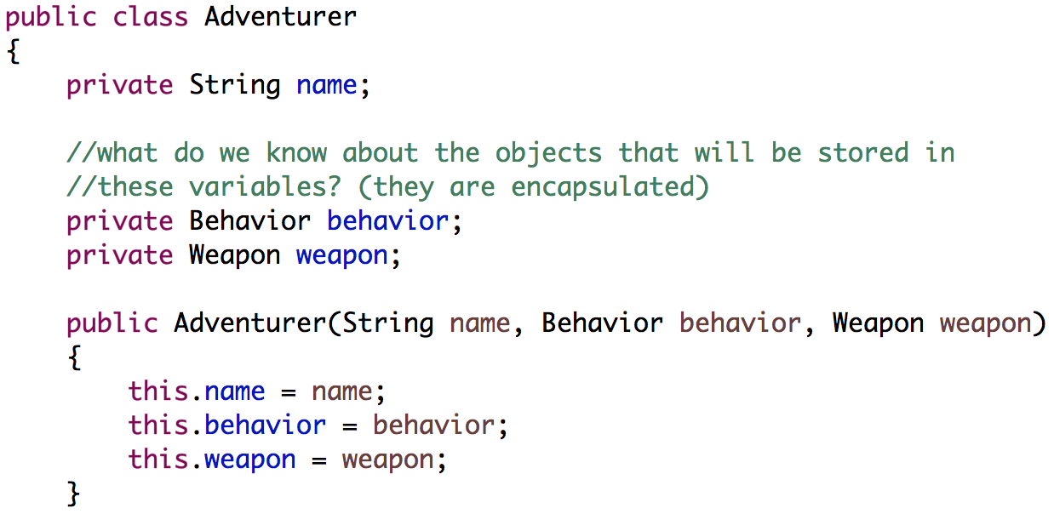
Step 2: use composition rather than inheritance
Store each algorithm that varies as a field in the client using the associated interface

Slide 18
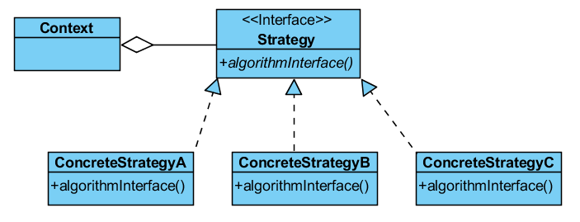
Let’s write some code

Slide 19
Sources
Gamma, Erich, et al. Design Patterns: Elements of Reusable Object-Oriented Software. Indianapolis, IN: Addison-Wesley, 1994

Slide 20
Design Patterns
The Strategy Pattern
IT 426

